Slide 1
User Experience Guide Wireframe Feedback Round 2 – Quick Start Guide
Remote, moderated 1:1 sessions with CACs
June 22 & 23 2020
Version: 1.0
Study Authors: Teri Brooks
Nina Ferreri
Human Factors Engineering (HFE)
Office of Health Informatics (10A7A)
Veterans Health Administration

Slide 2
Contents
Executive Summary
NPS and Debrief Comments
Study Details
Application Description
Study Objectives
Method
Detailed Task Findings
Conclusion and Next Steps

Slide 3
Executive Summary
June 22 and 23 seven VISN 15 CACs participated in remote, moderated 1:1 sessions.
A semi-functional prototype, built in Figma, was used for the testing.
The most serious barrier to this being utilized is CAC agency. If the UXG was recommended in an SOP, then the CACs would be more empowered to utilize the information and techniques.
No mobile use was evaluated.
No video content was available.

Slide 4
Executive Summary
Enhancements recommended in multiple areas.
Participants (4/7) said the QSG would be useful for new CACs. As well as a resource for experienced CACs.
Generally positive attitudes toward using sections of the QSG. CPRS guide and Kick-off meeting agenda specifically.
Generally positive attitudes toward recommending the QSG to others.
Terminology: Pain points, reminder dialog vs reminder definition, clinical reminder vs clinical reminder dialog.
Mixed comments regarding the printing function.
Mixed comments about breadcrumbs and backward navigation.
Comments that short and concise videos would be useful

Slide 5
NPS Ratings and Debrief Comments
On a scale of 1-5, where 1 is very unlikely and 5 is very likely, how would rate the possibility of pulling QSG sections to use in different kinds of projects.
Average rating = 4.5 or very likely
Which sections are you most likely to use. Feel free to click around the prototype.
I would only use the kickoff meeting. Maybe I'd go digging for issues but otherwise no.
All of them. (2)
The specific design guidance is the more useful to me right now because I'm still learning. Anything that specifically gave examples of what you can do and not do to make a reminder better.
I think the higher level stuff going through the usability testing stuff was interesting.
I’d use the visual modeling section.
I would use the CPRS design guide, everything you had in there i can see doing training or presentations on each one of those.

Slide 6
NPS Ratings and Debrief Comments
What else might be included or removed that would make the site more useful or valuable to you?
Code snippets, nothing else.
Not for me, but making it standard practice of the group provides a syllabus for the build and allows us to show the process of development and that’s important. It shows the workload and what's involved in building a clinical reminder.
Creating a reminder definition (the logic behind a clinical reminder); don’t have to have a definition to have a dialog, but if you want it smarter you have a definition; they're in a separate part of CPRS when you start a note that says reminders and if you click on it. The definition shows what is due; if the end user wants something more than a dialog (which can just be a template) with rules then it'd be developed at the same time as the dialog. I don't know much about definitions but it is complex. Even just for a beginning on how to make a definition and basic rules like timeframe based on age and gender; a how to on making a reminder definition would be good.
I'd expect to see code snippets on both the dialog and definition. If you're a new user you need to see all of that
Include a discussion board for people to pose questions or FAQs or a forum type thing for people to converse on their experiences.
I like everything that I see here. I'd like a search for anything. I want to be able to put the data object in the search line and it give me the places where I could find it so I'm not looking through the whole guide. One note search functionality.

Slide 7
NPS Ratings and Debrief Comments
Who else do you think could benefit from this site?
New CACs, the chiefs in each department might be able to use this. I think others could benefit from it. The basics of what the reminder dialogs can and cannot do and the kickoff meeting guide could be useful.
A good overview of any meeting could be useful.
ADPACs who work with different packages within Vista and CPRS. Lab informatics management roles maybe. Not sure how far into creating menus they get. Different facilities have different people responsible for orders and such.
Clinical ADPACs would benefit. I've noticed locally that we've had so many experienced ADPACs that have retired so new people don’t have the same knowledge base and we don’t have the means of re-training them. A lot of the time they are submitting the requests but don't understand what we need or why we need it. They'd benefit from the user interview guides.
NI, ADPACs. It'll vary based on what their roles really are. Maybe for clinic builds too. They are also built into CPRS like the reminders and order sets.

Slide 8
NPS Ratings and Debrief Comments
On a scale from 0-10, where 0 is not at all likely, and 10 is extremely likely, how likely are you to recommend this site to other (CACs, NIs)? Follow up: What would you tell them when recommending it to them?
This depends on the CAC, but 7 or 8. I'd definitely recommend it to a newer CAC to learn about it, but a more experienced CAC would laugh at me. They don’t need it.
9 or 10, especially if they are new. I'd tell them it is an excellent guide and resource for building a reminder or using it for usability in other areas. I can see it applying to other builds as well.
10. I would let them know that the site has really great guidance on creating reminder dialogs. And even if you have experience you can learn something new from this site.
10 definitely. I’d say that if you need guidance on how to build or make sure that you're getting the right information from your end users that this is a great place with resources to help you to develop your tool kit appropriately and effectively.
7. I’d tell them that it would be a great place to find processes for gathering information for their clinical reminder or order set builds.
In the current state, 7, because some content needs tweaking but I think this has potential to easily be a 10. I’d say if you use any one thing from this, use the kickoff meeting agenda and the how to user interview guide. Those are pieces that would improve development everywhere. We don't have a lot of opportunity to learn those skills.
10 easy. I would tell them that there is a lot of good information in this guide. There are great tips on how to get a project meeting started, on how to work through that plan stuff. I would tell them the CPRS design guide is extremely informative and has great tips especially for beginning CACs and would be a good place for them to start when their skillset is developing still on how to put reminder dialogs together. This is something we can go back to for our own library

Slide 9
Study Details
Study authors: Teri Brooks, Nina Ferreri
VA Contact: Stephanie Tallett
Stimuli: User Experience Guide website prototype
Division of Human Factors Engineering, CIDMO
Figma Prototype running on Chrome – Desktop version only tested

Slide 10
Application Description
The Human Factors Engineering division is developing a website targeted to VAMC facility staff.
The site will be called User Experience Guide (UXG)
Phase 1 of the site will include user-centered design tools for CACs and other facility staff. UXG will offer training in how to use in their local Clinical Reminder Dialogs.
The site is intended to be Walk Up and Use – no training for the site is planned, although the site will include training modules on specific topics.
Multiple rounds of concept development and prototype evaluation are planned, three have been completed at this time.

Slide 11
Study Objectives
Obtain feedback on the UXG wires for a Quick Start Guide. The Quick Start Guide tested was the Clinical Reminder Dialog. This study built on the first round of testing, which covered a Clinical Reminder Playbook.
Feedback from the first round indicated that the CACs perceived the Playbook as educational, but not applicable to their daily work.
This feedback led to a different type of presentation, the Quick Start Guide, utilizing progressive disclosure for those informaticists who wish to go deeper. The QSG job aids are written to be completed by CACs, with little or no additional training.
This study was to determine:
Did the QSG hit the sweet spot, for explaining What to do, and How to do it, but hiding the why and process descriptions?
Did the layout and content provide actionable tools to the target audience?
How would the participants integrate the UXG into their work?

Slide 12
Method
7 participants, all with the role of CAC or Lead CAC were scheduled for participation.
All sessions were conducted on Skype between June 22-23, 2020 and screen/audio recordings were made.
Participants reviewed a consent form and verbally agreed to it before continuing.
Participants performed a think aloud with mouse control of the Figma prototype.
Not all content was covered with each participant. Sessions end promptly to respect scheduling constraints. When the participant started late, the moderator will ask if they can stay a few more minutes.

Slide 13
Method: Consent Agreement
I voluntarily agree to participate in an evaluation being conducted by User-View, Inc. of Raleigh, North Carolina.
During the evaluation, I understand that I may learn information that is confidential to User-View or its clients. I agree to treat all information received during this evaluation as confidential. Accordingly, I will not disclose confidential information to any third parties
I authorize User-View and their client to keep, preserve, use in any manner and dispose of the findings from this evaluation, including my feedback and opinions expressed. User-View and their client will not associate my name or organization name with the results of this evaluation.
I give my permission for User-View and their client to make screen and audio records of me during this evaluation. I understand that these recordings can be used only for evaluation purposes and can be used for no other purpose without my knowledge and consent.
I understand that my participation is completely voluntary. I understand that I can stop participating and that I may leave at any time. I agree to immediately raise any concerns or areas of discomfort with the study administrator.

Slide 14
Detailed Task Findings

Slide 15
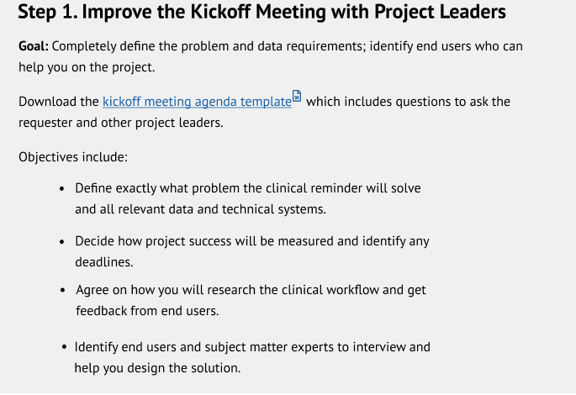
CAC Agency– Serious Impact
As previously noted, VAMCs utilize different processes. Most of the CACs indicated that they do not attend or schedule any type of kick off meeting. If they are invited to such a meeting, the service schedules it.
Participant: “We do not have a form already. Usually if it's in a meeting we are not the leads in the meetings. There is no form we just go through verbally and go from there. This form could be valuable. This is more like a checklist for a seasoned CAC so they are probably doing this already without thinking about it but it'd be good for a new CAC.”

Slide 16
CAC Agency– Serious Impact
One CAC indicated that they always schedule a kick-off meeting, two said sometimes depending on the size of the project.
Asked how they would go about making a process change in their environment, one participant indicated that the CHIO would need to be convinced, but that has been difficult in the past for other process changes.
Several referenced having a SOP that would outline this, then it would be much easier to implement.

Slide 17
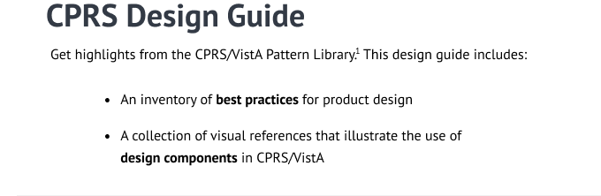
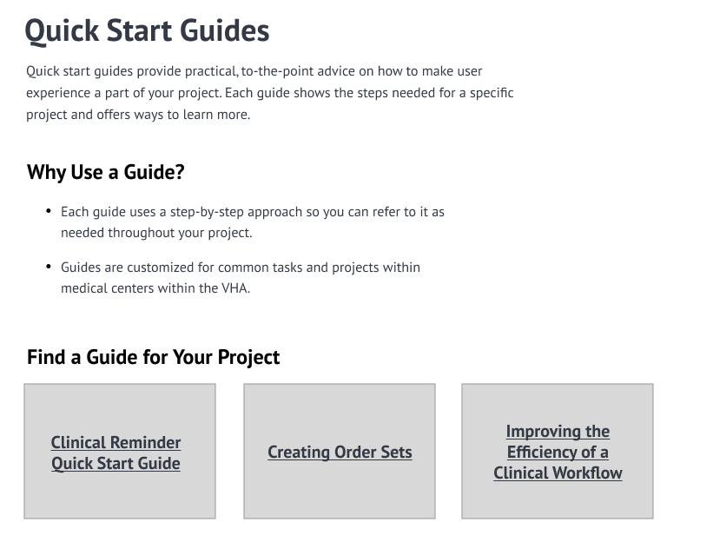
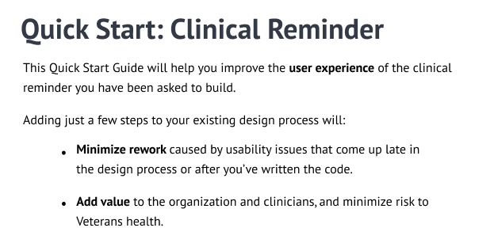
Strengths
The landing page text was read and favorably commented on across participants.
Participants relied on the introductory text to understand the site information.

Slide 18
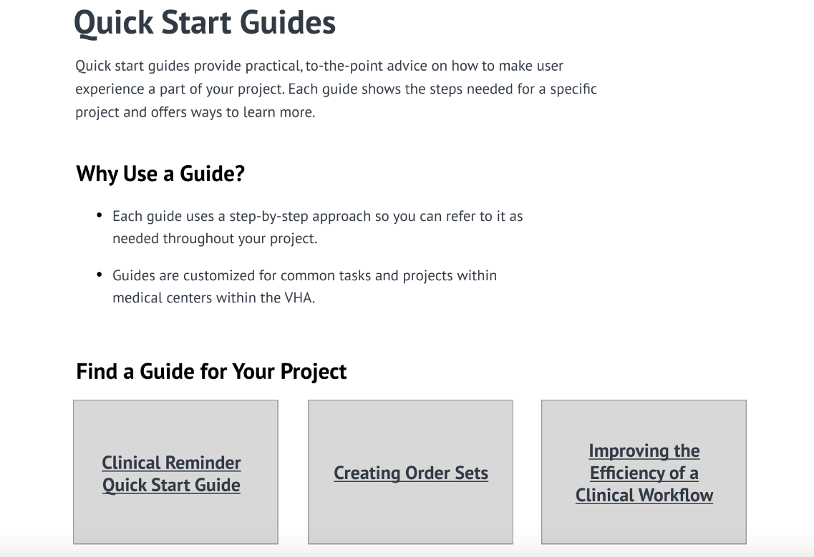
QSG Landing Page
Items to add:
Branching Logic and Encounter Form Set Up as boxes to additional guides.
Table of Contents to limit any searching they’d have to do on the page.
Required approvals e.g. facility leadership, chief, supervisor.

Slide 19
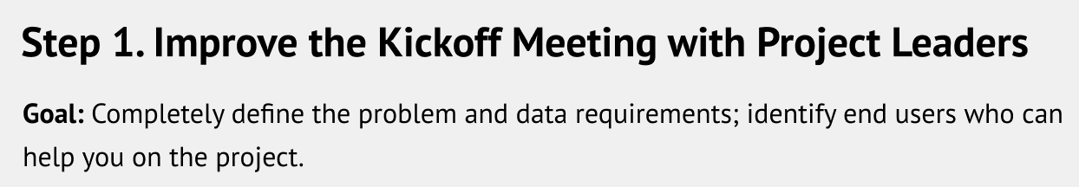
Clinical Reminder QSG landing page
Items to change:
The second phrase of Step 1 Goal could be misinterpreted by a new CAC. Rephrasing would be necessary.

Slide 20
Kickoff Meeting Agenda Template
There were mixed comments about whether or not CACs would use this. Holding meetings depends on the project. Typically, questions are asked via email or phone call, not through meetings.
One participant said they would prefer to have the kickoff meeting in another format so they do not need to go to the website to find it.
Items to change (image above):
Not sure what it is referring to. They suggested it be rephrased if the intent is to find out what type of data the staff intend to pull.
Also comment that “This is your lane!” is unclear.
Items to add:
Questions about the logic of the reminder should be added. “When will they expect to have it completed?” “How it will be resolved.” “What do they want the health factors to be?”
A question about urgency of the project with a scale and justification should be added.
4/7 participants showed interest in using the Kickoff meeting agenda.
2/7 participants indicated that these items should be added to the work request in their facility. LEAF and Sharepoint.

Slide 21
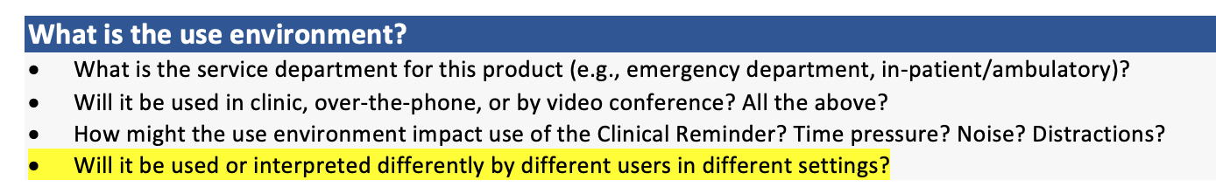
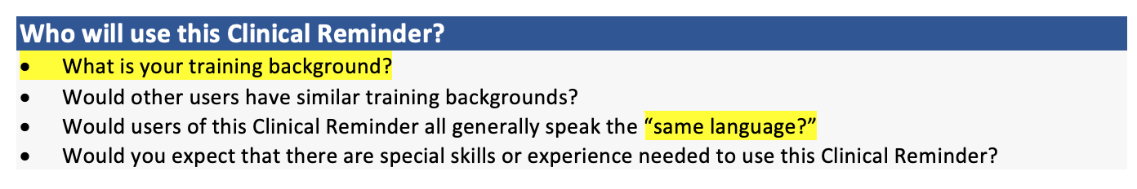
User Interview Guide Template doc
2/7 participants said they would use this document. 3/7 were confused about the purpose of this document. Participants did not grasp the difference since the questions are useful, but they thought the Kick Off agenda was a similar list.
Items to change (highlighted in images):
Rephrase training background to ”Tell me about your professional background”
Clarify what “same language” refers to.
Items to add:
How the end-users are affected by the reminder.
Questions related to reminder definition: Who is the cohort? Which patients will this apply to? How will it be resolved? When is it due? Will health factors be included and what will they be used to track?

Slide 22
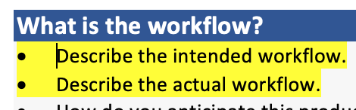
User Interview Guide Template doc (cont’d)
Items to change (highlighted in images):
Combine first and second times from workflow question into one item.
Rephrase “What is understanding of problem…” to “Describe the problem that the product build will solve?”

Slide 23
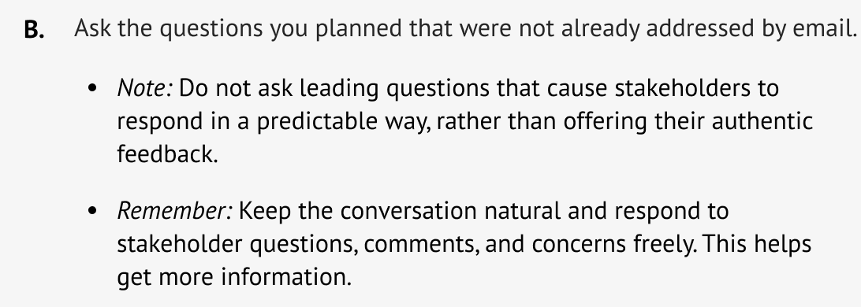
How to Interview Stakeholders
One participant said: “I probably would have skipped this information because I feel like I already covered it in the interview doc.”
There was confusion about the links in Best for These Project Phases.
Items to add:
Boxes like on the QSG landing page that stand out
Step 2B Remember: “Don’t be afraid to do additional research if necessary.”

Slide 24
How to Interview Users
Participants commented that they are not responsible for reaching out to the end-users. This is the role of the requester.
One participant commented that they thought this was the same thing as the User Interview Guide template.
There was confusion about the links in Best for These Project Phases.
Items to add:
Examples of a completed User Interview Guide. (Throughout participants comment that more examples would be useful.)

Slide 25
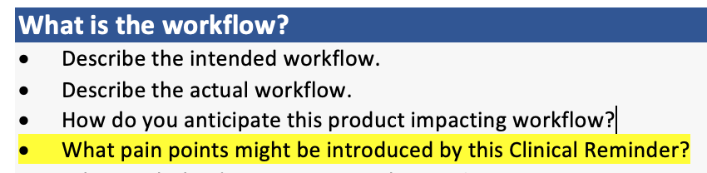
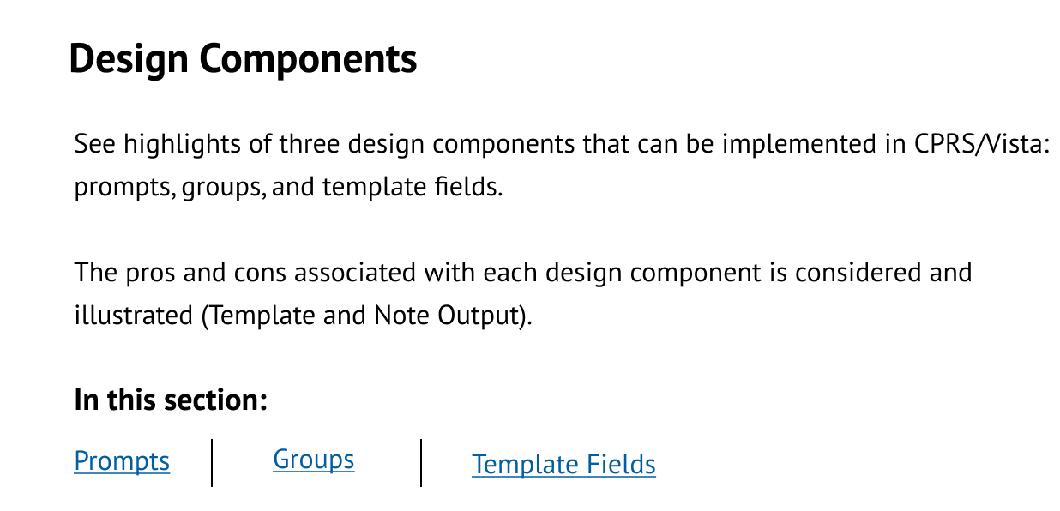
Terminology
“Pain” in Pain Points has a different meaning in clinical setting. Consider changing this term. “Challenge” was offered as a substitute.
Clinical Reminder is different from Clinical Reminder Dialog Template. Refer to it as such.
Change “Groups” to “Groups and Elements” on CPRS Design Guide page.

Slide 26
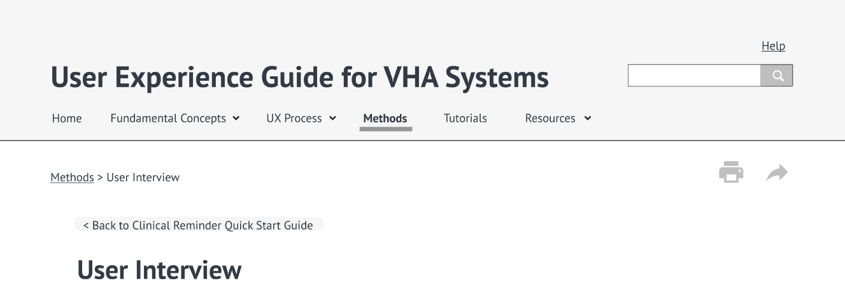
Printing
Participants said they would print sections over the whole page to build their own library.
Others said they would print the Kickoff meeting agenda and the User interview guide.
One participant said they would print examples of code snippets if site included these.
Another participant said that the print icon is not noticeable in its current location and would be more “user friendly” if it was in the top left corner. “I am used to the print function being under the File menu in the top left.”
One participant commented that the icons do not standout.

Slide 27
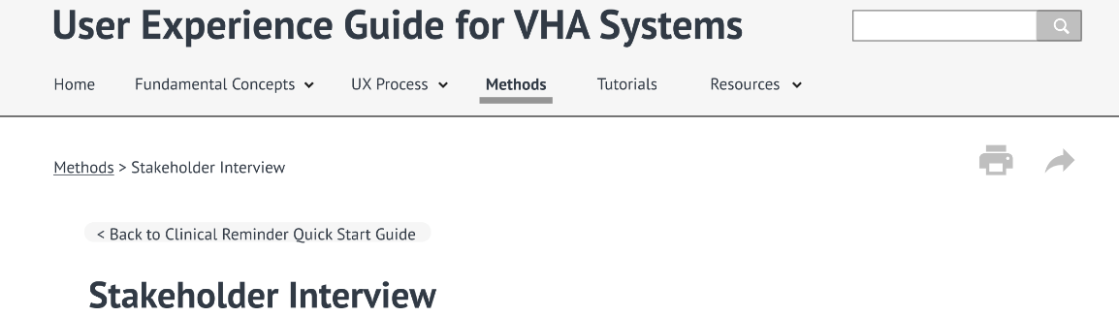
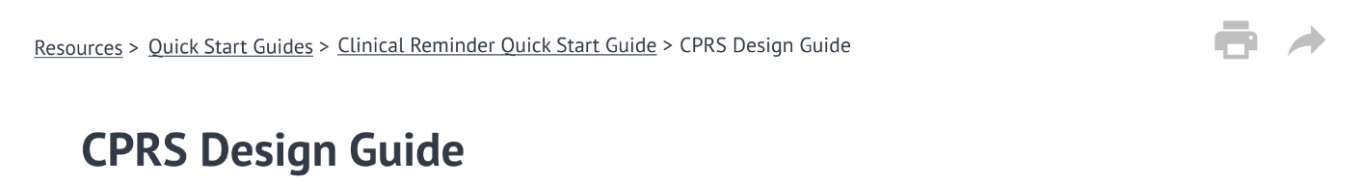
Breadcrumbs and Back to Top
Several participants had difficulty finding the breadcrumbs depending on the page.
Went to Home page from Stakeholder Interview page.
Almost went to Method from Stakeholder Interview page, but then found the correct breadcrumb.
Wanted to go to Resources from Stakeholder Interview page. Needed to be guided to correct breadcrumb.
Used browser back button from CPRS guide.
Not sure which link to use from CPRS guide page (Quick Start Guide or Clinical Reminder Quick Start Guide)
Participants wanted a quick way to get back to the top of the page. Recommend adding a Back to Top function.

Slide 28

Videos
Action Plan
No actual videos were included in the wireframes. The video placeholder drew attention and participants indicated that videos would be watched.
Participants commented that they would watch short and concise videos. Acceptable video length ranged from 2 minutes to 10 minutes.
Important that the video is short and concise, gets right to the point, and highlights the key points again at the end of the video.
Some participants said they would like to see video demonstrations of how to use these tools, e.g. Usability Walkthrough.

Slide 29
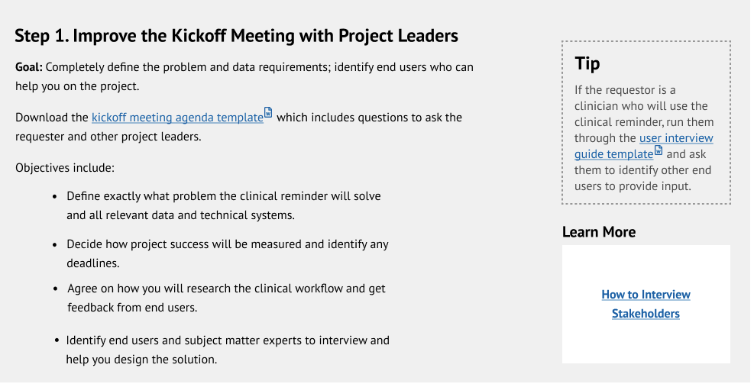
Tip and Learn More
Participants did not notice the Tip and Learn More areas on the page. When directed to them in order to obtain feedback, the How To sections were the least likely to be found useful. See slide 23-24 for detailed findings on How Tos.
Template labels vs How To is not something that is easily grasped when skimming the page. Possibly include the How To in the template, and then it can be printed, or not. Or increase the differentiation in the item labels.

Slide 30
Mock Up Usage
Use of mock-ups prior to CPRS configuration varied across participants.
All participants differentiated between small, medium and large projects, and indicated that this assessment partly determines the use of a mock up. However, several participants only configure in CPRS, put it in a test environment and work with the requestor on the design that way.
Tools in use: Word, Powerpoint, Excel. Several used to use Visio, but now that must be requested and it is not considered to be essential by participants.
"It is suggesting creating a mock-up somehow of the dialog or reminder. I don't do it in such a way that makes sense to the users but for what is organized for me. I just create a spreadsheet with the names of the groups and elements, the text and alt text and then build it so I don't have to go back and rework it."
Several participants would like to see a SOP that included the steps covered in the QSG.

Slide 31
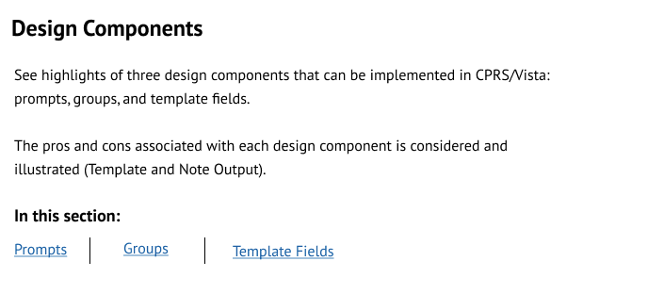
Pattern Library Enhancements
Data objects
Participants were not sure what to expect, but this link was of interest across all participants.
Participants liked the Best Practices, asked to have more included in that section, but the section itself takes a long time to scroll through.
Examples shown were deemed useful across 6/7 participants.
Add Data Objects as a 4th Design Component.
Participant comments:
I wanted to see how the dialog will work within the environment itself. Maybe use it as a template for an issue that comes up.
I hope I’d get maybe a link to current CPRS technical guides or other types of CPRS info like patch information that is getting ready to be released, what's involved, updates that have been done, maybe a history.

Slide 32
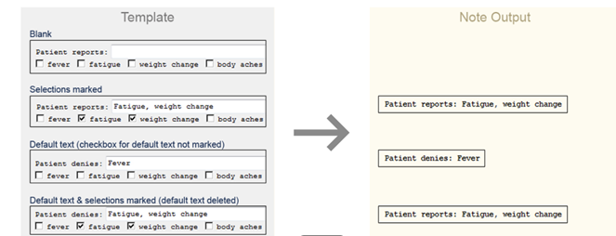
Pattern Library Enhancements cont’d
Participant Comments:
I know this is for reminder dialogs but we do boiler plates and TXML (?) templates which are built in the template editor, it'd be nice in this before we get to reminder dialog if we could get a definition of each of those. Plus the pros and cons because there are things you can’t do in a boiler plate that you might be able to do in a TXML.
I don’t understand the first bullet for the “Cons” section, I can’t even say that it’s not true because I don’t know what they are trying to say.
Suggestions for enhancing the pattern library include:
Add the Reminder Definition section (see Reminder Definition for more detail)

Slide 33
Common Usability Issues
Participants saw value in this content, and would like this section to include more examples, as well as the code snippet so they could follow along.
Participant Comments:
I like the fact that these appear to have FAQs in them and that will help with issues with instillation of reminder dialogs and that I think they are overlooked during deployment.
People have different issues. If there is a quick way to be able to go and pull up that information that is very useful and of value to the person building the reminder dialog.
I think they are all good. I don’t know if there are other ones that link from the in-depth guide. I think it'd help if there is other guidance that applies here.
I would use this information. I'd be interested in seeing others listed here too.
It's all really useful and good information. I could use this. We have so many providers that don’t know how to get to clinical reminders. It would be helpful for the provider to know how to get to clinical reminders and how to use them. I guess this isn't the right location for that, but I guess we're assuming they already know that with this.

Slide 34
Common Usability Issues (cont’d)
Participants saw value in this content, and would like this section to include more examples, as well as the code snippet so they could follow along. Bolded comment introduces a topic not yet covered in the UXG.
Participant Comments:
I'd like to have the code example next to it to show how it should look when someone runs into an issue. Just telling that it's an issue but not showing how to correct it is not helpful.
I think this is really good. A lot of people are very visual so seeing something like this is helpful to put an image in the mind to be able to think about how this goes and should look.
Very often the stance I take is, I put myself in the view of the provider to think about what they will see, then I put myself in the patient’s shoes to think of what the patient will see and how it'll read for them. I have a lot of conversations with my end-users to compare what they will see and what the patient will see if they ever request the record so they can understand what they will see. I think this would be a good place to cover that.
Consistency point is great. I don’t think this can be stated enough. I agree with that absolutely. I don’t think there is anything I can add to that. Very well stated.

Slide 35
Visual Modeling
Workflow mapping as a concept was well understood. The value in workflow modeling is recognized.
Participant Comments:
I use this. I don’t know that ever CAC does that. I like mapping it out so I can find bottlenecks and help generate solutions or point me to someone who can help generate a solution.
I would be interested to see examples or demonstrations. But I may not have time to integrate this.
If I could convince my facility leadership on how we could approach these things more constructively then it would be a really great tool. I have tried to use the approach that being proactive with creating tools that support our clinicians will make their jobs easier and give them back some time. I think that's what they would value. If we can make better tools for the clinicians that free up time, they should want us to be able to do that.
I guess an example would be whenever we share screens and show the end user and go over the functionality. Sometimes I'll do it differently [2 or more designs] to show a different format that might be more user friendly for them.

Slide 36
Add Reminder Definition
Reminder Definition is done at the same time as the dialog build.
The Reminder Definition specifies the rules that are required to have the reminder dialog function correctly.
Participants expect the rules to be identified during the early meetings (with requester, end user or the kick-off meeting).
Some examples:
Timing: when should it appear?
Which populations should the dialog apply to?
How will the reminder be resolved?
Other rules as described by the requester.
Recommend further research into the definitions to determine if they would be a part of the UXG. If not a part of the UXG, the questions related to the definition should still be added to the Kick off agenda and user interview guide for completeness.

Slide 37
Conclusion and Next Steps
The Quick Start Guide format and content received a positive reception. While many enhancements were recommended, the content provided was considered useful.
Two interviews were conducted on June 25 to provide the CHIO/management perspective on how the UXG could benefit the facility informaticists, and how the benefit would be measured.
The information collected in those interviews should be used in conjunction with the enhancements and issues identified in this readout.

Slide 38
Appendix - Severity Ranking System
Minor | One or more of the following: □ Causes user hesitation, confusion, or slight irritation. □ Impedes task completion or decreases efficiency but does not cause task failure. □ Presents small likelihood that the credibility of the VA HIT product will be diminished. | Consider resolving this issue. | Use of “Click here for more” to take user to an external link.
Moderate | One or more of the following: □ Causes occasional task failure after which recovery is possible. □ Causes user delays and/or moderate dissatisfaction, but some users are able to recover in order to complete the task. □ Expected to negatively impact use, possibly leading to dissatisfaction at a level that users might opt to discontinue use. □ May diminish the credibility and/or reputation of the VA product. | Give high priority to resolving this issue. | Inconsistent access to app navigation (e.g., menu button alternates between the right and left side, depending on page).
Serious | All of the following: □ Causes frequent task failure or occasional task failure from which recovery is not possible. □ Causes extreme user irritation and/or task abandonment. □ Likely to diminish the credibility or reputation of the VA product. Or: □ Causes system/sub-system failure (i.e., produces system error or “crash”). | Give highest priority to resolving this issue prior to further product testing or release. HFE recommends resolution or mitigation for serious usability issues before deploying products. | Blank page in app. Broken [external] web link (e.g., link has changed). Inaccessible web link (e.g., link is behind firewall, but app user is not). Use of language that is not easily comprehended by end users.
Not Applicable | Strengths or Unsolicited Suggestions Any findings related to strengths in the system (or unsolicited suggestions for improvement, which are not related to a usability weakness). In UI Cert: Criteria not applied. | Optional. | UI Cert: If app does not have sound features, criteria S-01 is not applicable. If app is 'read only,' criteria I-02 is not applicable. If app does not support processing tasks, criteria C-07 is not applicable.
Not Evaluated | In UI Cert: Reviewer did not come across (observe) criteria, so cannot say if criteria is met or not. This can be because function is not working or reviewer could not create the circumstances to support evaluation. |  | UI Cert: If reviewer does not come across error messages, criteria E-02 is not evaluated (because a different set of key presses or network speed might allow for it to be evaluated at another time). If reviewer does not come across pages that take 1-10 seconds to load, criteria C-06 is not evaluated (because a different set of devices + network speed might allow for it to be evaluated at another time).

